Slide 1
Compiler Design
23CS5PECPD – Unit 5
Prof. SNEHA S BAGALKOT
Assistant Professor, Dept. of CSE

Slide 2
UNIT – 5: Run-Time Environments
Run-Time Environments:
Storage Organization,
Stack Allocation of Space.
Code Generation: Issues in the design of Code Generator,
The Target language,
Addresses in the target code,
Basic blocks and Flow graphs,
Optimization of basic blocks,
A Simple Code Generator.

Slide 3
Outline
Compiler must do the storage allocation and provide access to variables and data
Memory management
  Stack allocation
  Heap management
  Garbage collection

Slide 4
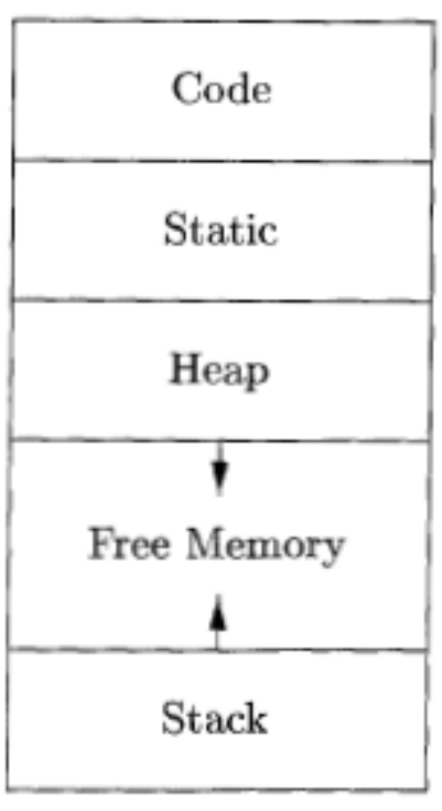
Storage Organization
Typical subdivision of run-time memory into code and data areas

Slide 5
Static vs. Dynamic Allocation
Static: Compile time, Dynamic: Runtime allocation
Many compilers use some combination of following
  Stack storage: for local variables, parameters and so on
  Heap storage: Data that may outlive the call to the procedure that created it
Stack allocation is a valid allocation for procedures since procedure calls are nested

Slide 6
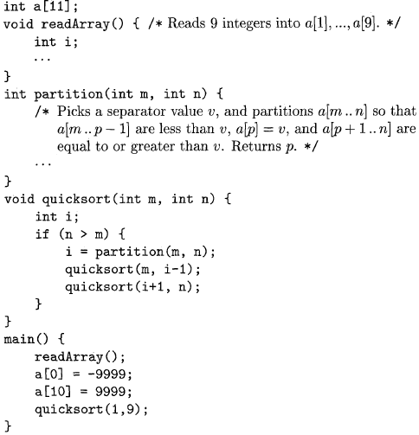
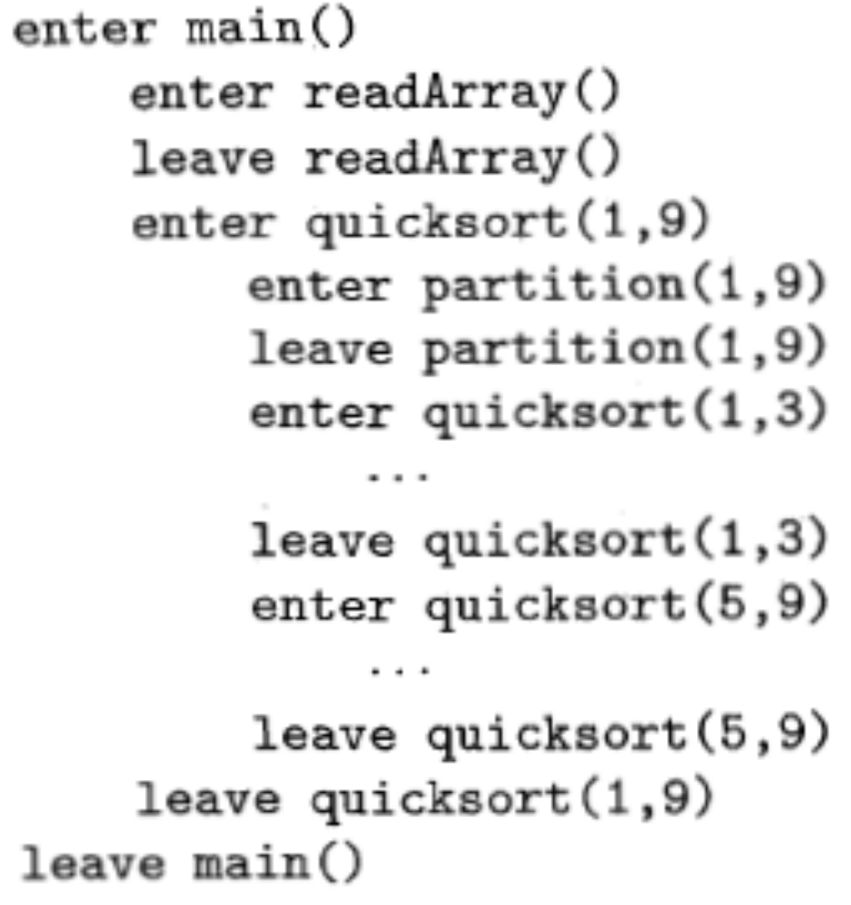
Sketch of a quicksort program
Activation for Quicksort

Slide 7
Activation for Quicksort

Slide 8
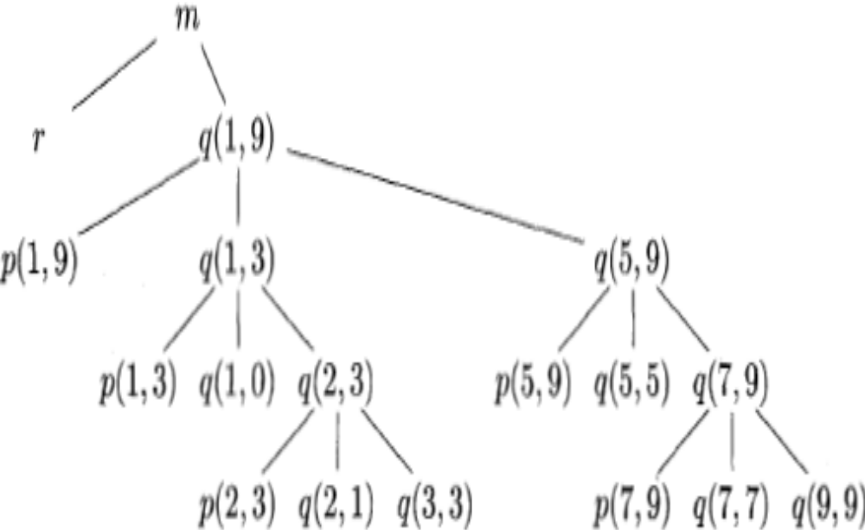
Activation tree representing calls during an execution of quicksort

Slide 9
Activation records
Procedure calls and returns are usually managed by a run-time stack called the control stack.
Each live activation has an activation record (sometimes called a frame)
The root of activation tree is at the bottom of the stack
The current execution path specifies the content of the stack with the last activation has record in the top of the stack.

Slide 10
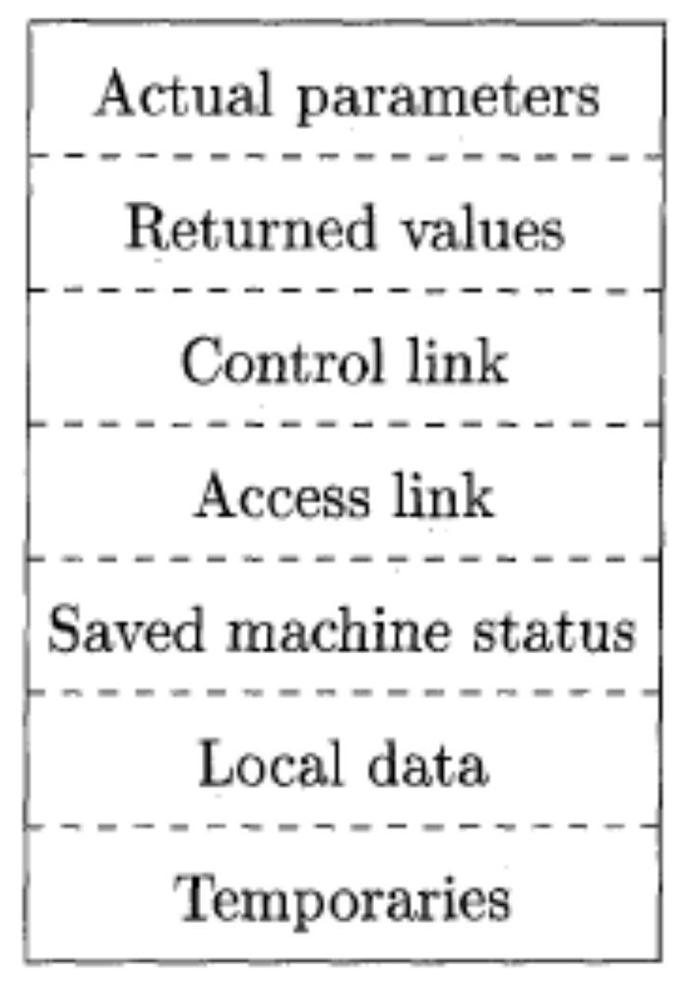
A General Activation Record

Slide 11
Activation Record
Temporary values
Local data
A saved machine status
An “access link”
A control link
Space for the return value of the called function
The actual parameters used by the calling procedure

Slide 12
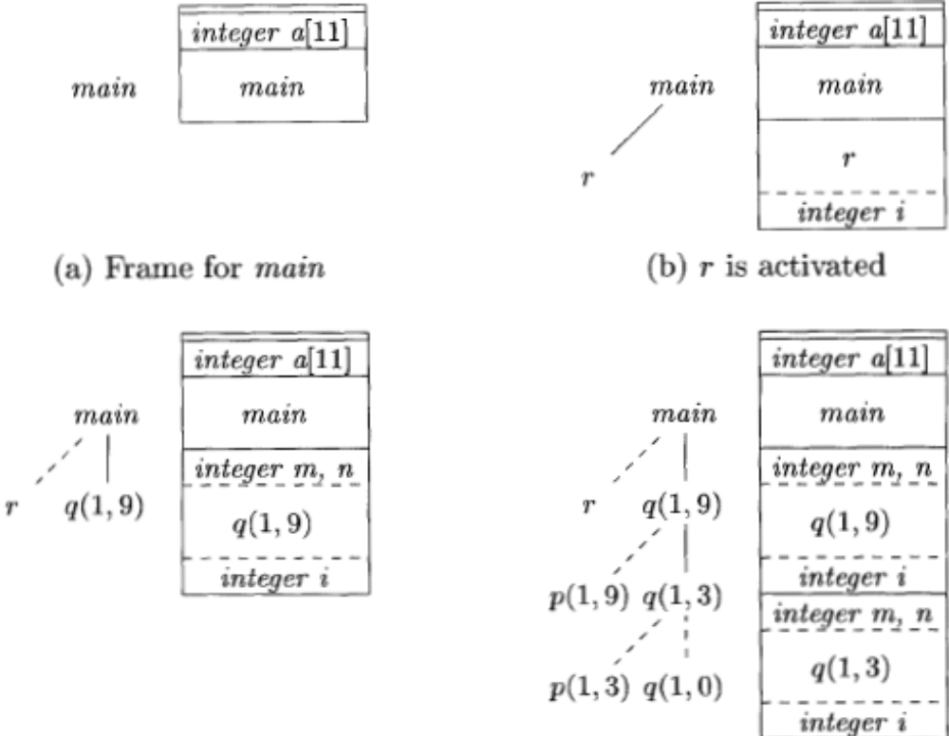
Downward-growing stack of activation records
(c) r has been popped and q(1,9) pushed (d) Control returns to q(1,3)

Slide 13
Designing Calling Sequences
Values communicated between caller and callee are generally placed at the beginning of callee’s activation record
Fixed-length items: are generally placed at the middle
Items whose size may not be known early enough: are placed at the end of activation record
We must locate the top-of-stack pointer judiciously: a common approach is to have it point to the end of fixed length fields.

Slide 14
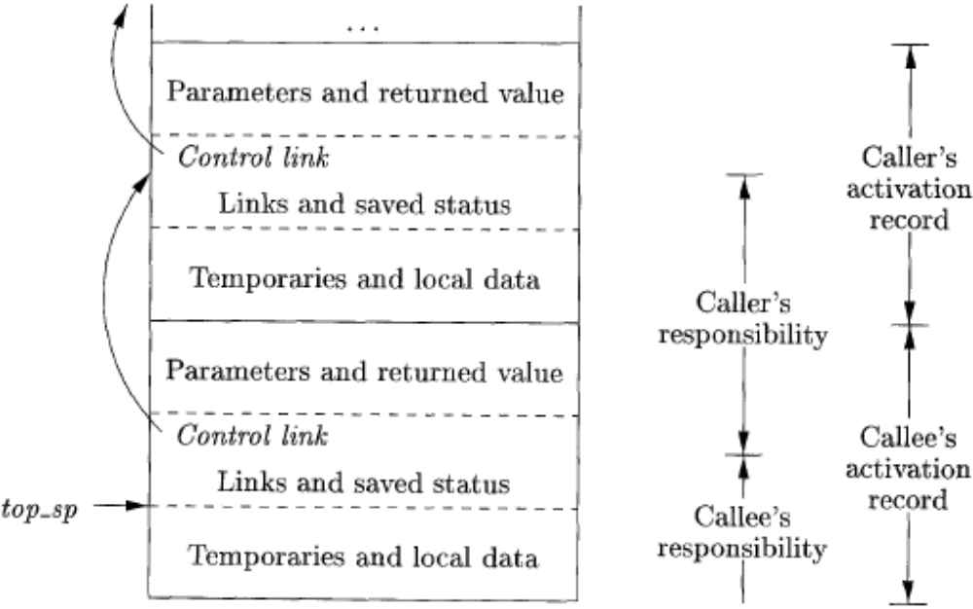
Division of tasks between caller and callee

Slide 15
Calling sequence
The caller evaluates the actual parameters
The caller stores a return address and the old value of top-sp into the callee's activation record.
The callee saves the register values and other status information.
The callee initializes its local data and begins execution.

Slide 16
Corresponding return sequence
The callee places the return value next to the parameters
Using information in the machine-status field, the callee restores top-sp and other registers, and then branches to the return address that the caller placed in the status field.
Although top-sp has been decremented, the caller knows where the return value is, relative to the current value of top-sp; the caller therefore may use that value.

Slide 17
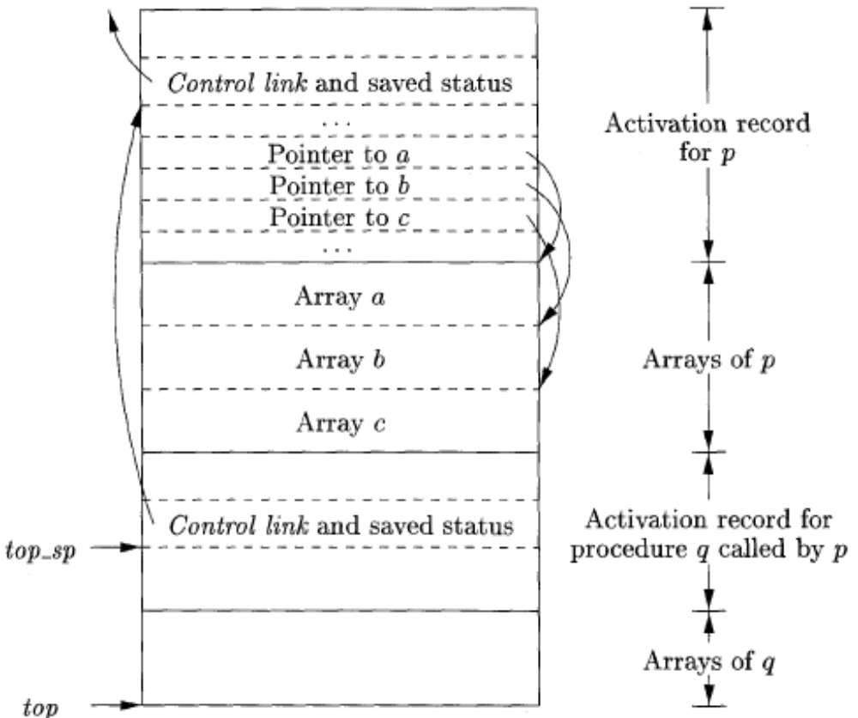
Access to dynamically allocated arrays

Slide 18
Code Generation

Slide 19
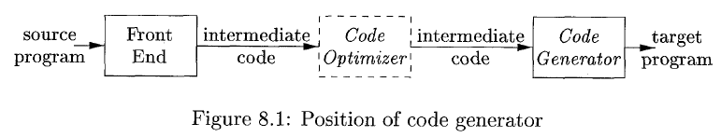
Introduction
Code Generation takes as input the intermediate representation (IR) produced by the front end of the compiler, along with relevant symbol table information, and produces as output a semantically equivalent target program.
The target program must preserve the semantic meaning of the source program and be of high quality;
The code optimization and code-generation phases of a compiler, often referred to as the back end, may make multiple passes over the IR before generating the target program.

Slide 20
Code Generator
A code generator has three primary tasks:
Instruction selection,
Register allocation and assignment,
Instruction ordering.

Slide 21
Code Generator
Instruction selection involves choosing appropriate target-machine instructions to implement the IR statements.
Register allocation and assignment involves deciding what values to keep in which registers.
Instruction ordering involves deciding in what order to schedule the execution of instructions.
Algorithms
Basic Blocks - consist of sequences of instructions that are always executed together.

Slide 22
Issues in the Design of a Code Generator
Correctness of Code.
Design Issues:
Input to the Code Generator
The Target Program
Instruction Selection
Register Allocation
Evaluation Order

Slide 23
Input to the Code Generator
Intermediate representation of the source program
Information in the symbol table
Choices for the IR
Three-address representations such as quadruples, triples, indirect triples
Virtual machine representations such as bytecodes and stack-machine code
Linear representations such as postfix notation
Graphical representations such as syntax trees and DAG's

Slide 24
Input to the Code Generator
Assumptions:
The front end has scanned, parsed, and translated the source program into a relatively low-level IR
All syntactic and static semantic errors have been detected
The necessary type checking has taken place
Type conversion operators have been inserted wherever necessary.

Slide 25
The Target Program
The instruction-set architecture of the target machine has a significant impact on the difficulty of constructing a good code generator that produces high-quality machine code.
Target-machine architectures:
RISC (reduced instruction set computer)
CISC (complex instruction set computer)
Stack based machine

Slide 26
The Target Program
Java Virtual Machine (JVM)
Just-in-time (JIT) Java compilers
Producing a Relocatable machine-language program as output
Producing an assembly-language program as output

Slide 27
Instruction Selection
The code generator must map the IR program into a code sequence that can be executed by the target machine.
The complexity of performing this mapping is determined by factors like:
The level of the IR
The nature of the instruction-set architecture
The desired quality of the generated code.

Slide 28
Instruction Selection
If the IR is high level, the code generator may translate each IR statement into a sequence of machine instructions using code templates.
The nature of the instruction set of the target machine has a strong effect on the difficulty of instruction selection.
Instruction speeds and machine idioms are other important factors
For each type of three-address statement, we can design a code skeleton that defines the target code to be generated for that construct.

Slide 29

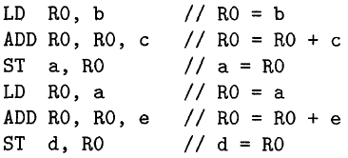


Instruction Selection
Every three-address statement of the form x = y + z, where x, y, and z are statically allocated, can be translated into the code sequence
The sequence of three-address statements would be translated into
The quality of the generated code is usually determined by its speed and size.
"Increment" instruction (INC) a = a + 1 by INC a

Slide 30
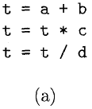
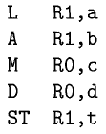
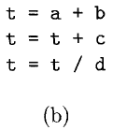
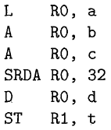
Register Allocation
Registers are the fastest computational unit on the target machine, but we usually do not have enough of them to hold all values.
Instructions involving register operands are shorter and faster than those involving operands in memory, so efficient utilization of registers is particularly important.

Slide 31
Register Allocation
The use of registers is often subdivided into two sub problems:
1. Register allocation, during which we select the set of variables that will reside in registers at each point in the program.
2. Register assignment, during which we pick the specific register that a variable will reside in.
Finding an optimal assignment of registers to variables is difficult, even with single-register machines.
Ex: M x, y D x, y

Slide 32
Evaluation Order
The order in which computations are performed can affect the efficiency of the target code.
Some computation orders require fewer registers to hold intermediate results than others.
Picking a best order in the general case is a difficult NP-complete problem.
Initially, we shall avoid the problem by generating code for the three-address statements in the order in which they have been produced by the intermediate code generator.
Code scheduling for pipelined machines that can execute several operations in a single clock cycle.

Slide 33
The Target Language
In this chapter, we shall use as a target language assembly code for a simple computer that is representative of many register machines.
The code generation techniques presented in this chapter can be used on many other classes of machines as well.

Slide 34
The Target Language
A Simple Target Machine Model
Our target computer models a three-address machine with load and store operations, computation operations, jump operations, and conditional jumps.
The underlying computer is a byte-addressable machine with n general-purpose registers, R₀, R₁, . . . , R_{n - 1}.
Most instructions consists of an operator, followed by a target, followed by a list of source operands. A label may precede an instruction.

Slide 35
A Simple Target Machine Model
Kinds of instructions:
1. Load operations
LD dst, addr dst = addr
Ex: LD r, x which loads the value in location x into register r.
LD rl, r2 is a register-to-register copy in which the contents of register r₂ are copied into register r_{l}.
2. Store operations
ST x, r stores the value in register r into the location x. x = r

Slide 36
A Simple Target Machine Model
3. Computation operations OP dst, src₁, src₂
OP is a operator like ADD or SUB, and dst, src_{l} , and src₂ are locations, not necessarily distinct.
Ex: SUB r_{l} , r₂ , r₃ r_{l} = r₂ – r₃
4. Unconditional jumps
BR L causes control to branch to the machine instruction with label L.
5. Conditional jumps Bcond r, L
Ex: BLTZ r, L causes a jump to label L if the value in register r is less than zero, and allows control to pass to the next machine instruction if not.

Slide 37
A Simple Target Machine Model
Addressing modes:
A location can be a variable name x referring to the memory location that is reserved for x (that is, the 1-value of x).
Indexed address: The form a(r), where a is a variable and r is a register.
Ex: LD R₁, a(R₂) => R_{l} = contents (a + contents ( R₂ )
Accessing arrays, where a is the base address of the array and r holds the number of bytes past that address

Slide 38
A Simple Target Machine Model
Integer indexed by a register:
Ex: LD R₁, l00(R₂) => R₁ = contents(100 + contents(R₂))
Two indirect addressing modes: *r means the memory location found in the location represented by the contents of register r and *100(r) means the memory location found in the location obtained by adding 100 to the contents of r.
Ex: LD R₁, * 100 (R₂) => R₁ = contents(contents(l00 + contents(R₂)))
Immediate constant addressing mode: prefix #
Ex: LD R₁, #100 ; ADD R₁, R₁, #100

Slide 39
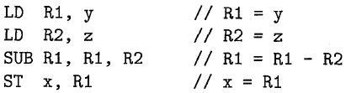
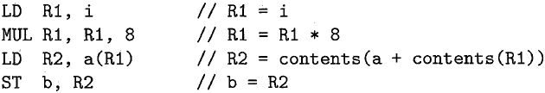
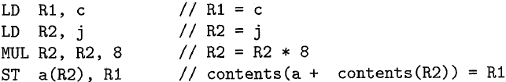
A Simple Target Machine Model
Examples:
x = y – z
b = a [i]
a[j] = c

Slide 40


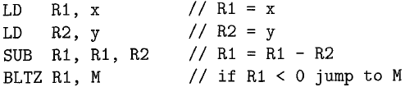
A Simple Target Machine Model
Examples:
4. x = *p
5. *p = y
6. if x<y
goto M

Slide 41
Program and Instruction Costs
Common cost measures:
Length of compilation time and the size,
Running time
Power consumption of the target program.
Examples of Cost of each instruction:
LD R₀, R₁ Cost=1
LD R₀, M Cost=2
LD R₁, *100(R₂) Cost=3

Slide 42
Addresses in the Target Code
Names in the IR can be converted into addresses in the target code by looking at code generation
Logical address space that was partitioned into four code and data areas:
A statically determined area Code that holds the executable target code.
A statically determined data area Static for holding global constants and other data generated by the compiler.

Slide 43
Addresses in the Target Code
3. A dynamically managed area Heap for holding data objects that are allocated and freed during program execution.
4. A dynamically managed area Stack for holding activation records as they are created and destroyed during procedure calls and returns.

Slide 44
Static Allocation
Three-address statements:
call callee
return
halt
action, which is a placeholder for other three-address statements.

Slide 45
Static Allocation
Ex: Static Allocation -> target-machine instructions:
ST callee.staticArea, #here + 20
BR callee.codeArea
Return Statement:
BR *callee.staticArea

Slide 46
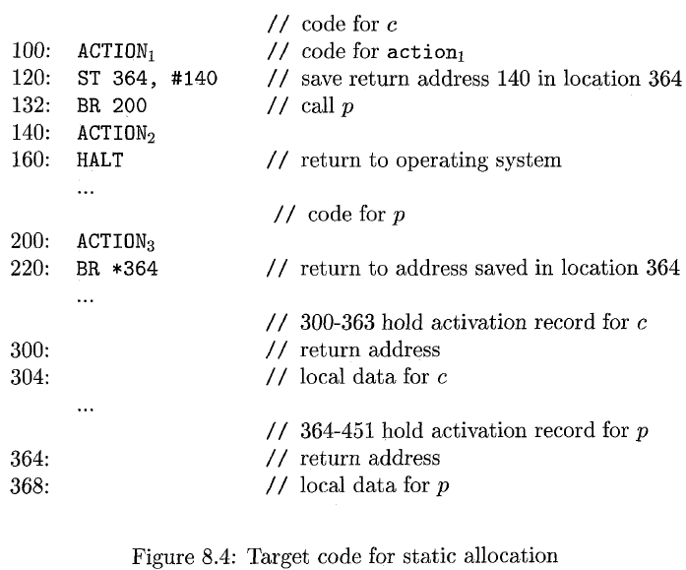
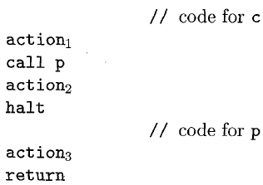
Static Allocation
Example: three-address code

Slide 47


Stack Allocation
Static allocation can become stack allocation by using relative addresses for storage in activation records.
Stack Pointer SP
First procedure
Procedure call sequence
Return sequence in called procedure
Return sequence in called procedure

Slide 48
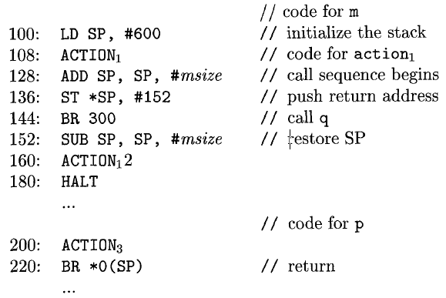
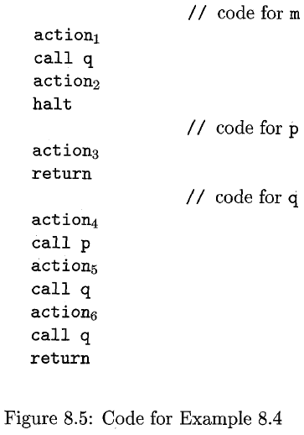
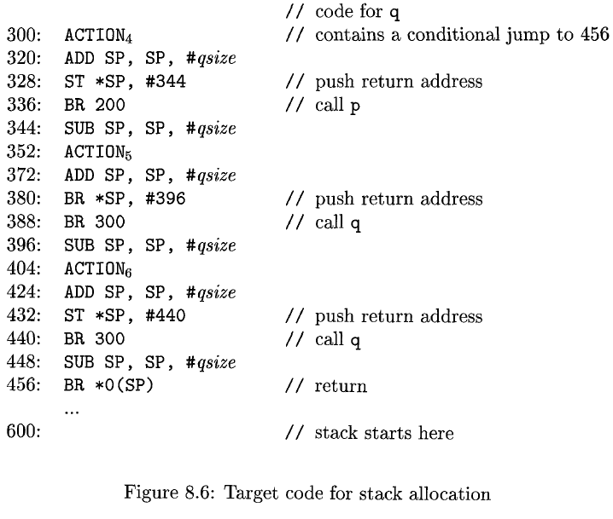
Stack Allocation
Example: Quicksort Program

Slide 49
Run-Time Addresses for Names
A name in a three-address statement is really a pointer to a symbol-table entry for that name.
Adv: it makes the compiler more portable, since the front end need not be changed even when the compiler is moved to a different machine where a different run-time organization is needed.
Names must eventually be replaced by code to access storage locations.

Slide 50
Run-Time Addresses for Names
Ex: simple three-address copy statement x = 0.
Suppose the symbol-table entry for x contains a relative address 12 for x.
x is in a statically allocated area beginning at address static.
Then the actual run-time address of x is static + 12.
The assignment x = 0 then translates into
static[12] = 0
If the static area starts at address 100, the target code for this statement is
LD 112, #0

Slide 51
Basic Blocks and Flow Graphs
A graph representation of intermediate code is introduced that is helpful for discussing code generation even if the graph is not constructed explicitly by a code-generation algorithm.

Slide 52
Basic Blocks and Flow Graphs
The representation is constructed as follows:
Partition the intermediate code into basic blocks, which are maximal sequences of consecutive three-address instructions with the properties that
(a) The flow of control can only enter the basic block through the first instruction in the block. That is, there are no jumps into the middle of the block.
(b) Control will leave the block without halting or branching, except possibly at the last instruction in the block.
2. The basic blocks become the nodes of a flow graph, whose edges indicate which blocks can follow which other blocks.

Slide 53
Basic Blocks
Our first job is to partition a sequence of three-address instructions into basic blocks.
We begin a new basic block with the first instruction and keep adding instructions until we meet either a jump, a conditional jump, or a label on the following instruction.
In the absence of jumps and labels, control proceeds sequentially from one instruction to the next.

Slide 54
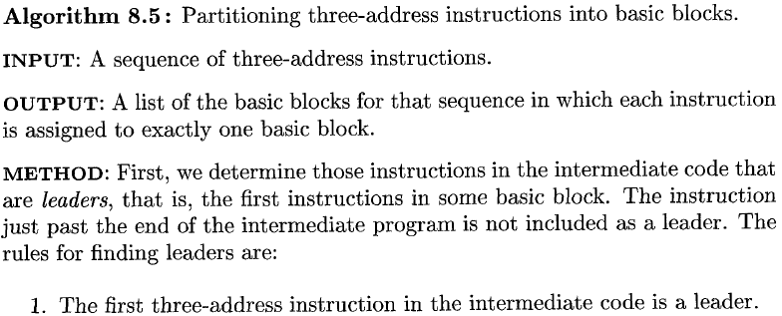
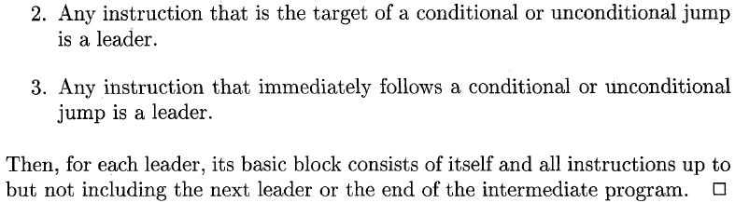
Algorithm for Basic Blocks

Slide 55
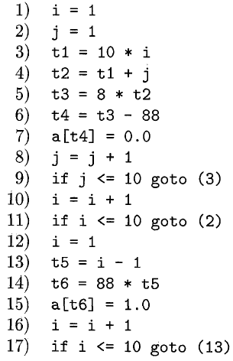
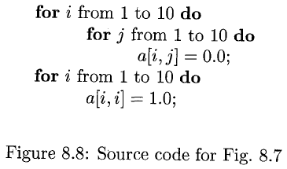
Example : Identity Matrix

Slide 56
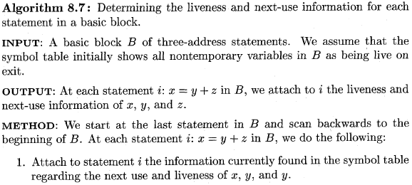
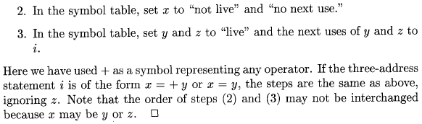
Next-Use Information
Knowing when the value of a variable will be used next is essential for generating good code.

Slide 57
Flow Graphs
Once an intermediate-code program is partitioned into basic blocks, we represent the flow of control between them by a flow graph.
The nodes of the flow graph are the basic blocks.
There is an edge from block B to block C if and only if it is possible for the first instruction in block C to immediately follow the last instruction in block B.

Slide 58
Flow Graphs
There are two ways that such an edge could be justified:
There is a conditional or unconditional jump from the end of B to the beginning of C.
C immediately follows B in the original order of the three-address instructions, and B does not end in an unconditional jump.
We say that B is a predecessor of C, and C is a successor of B.
We add two nodes, called the entry and exit, that do not correspond to executable intermediate instructions.

Slide 59
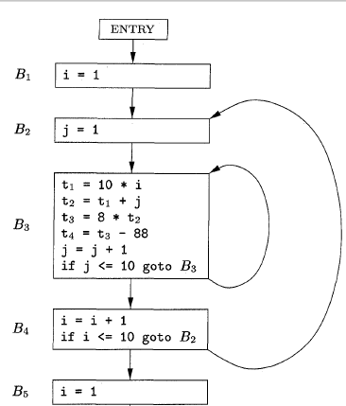
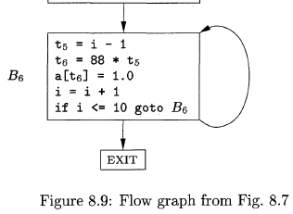
Flow Graphs Example

Slide 60
Representation of Flow Graphs
In the flow graph, it is normal to replace the jumps to instruction numbers or labels by jumps to basic blocks.
Flow graphs, being quite ordinary graphs, can be represented by any of the data structures appropriate for graphs.
The content of nodes (basic blocks) need their own representation.
It is more efficient to create a linked list of instructions for each basic block.

Slide 61
Representation of Flow Graphs
Loops
Many code transformations depend upon the identification of "loops" in a flow graph.
We say that a set of nodes L in a flow graph is a loop if
1. There is a node in L called the loop entry with the property that no other node in L has a predecessor outside L.
2. Every node in L has a nonempty path, completely within L, to the entry of L.
Example 8.9 : The flow graph of Fig. 8.9 has three loops:
1. B₃ by itself.
2. B₆ by itself.
3. {B₂, B₃, B₄}

Slide 62
Optimization of Basic Blocks
We can often obtain a substantial improvement in the running time of code merely by performing local optimization within each basic block by itself.
More thorough global optimization, which looks at how information flows among the basic blocks of a program.

Slide 63
Optimization of Basic Blocks
The DAG Representation of Basic Blocks
Transforming a basic block into a DAG (directed acyclic graph).
We construct a DAG for a basic block as follows:
1. There is a node in the DAG for each of the initial values of the variables appearing in the basic block.
2. There is a node N associated with each statement s within the block. The children of N are those nodes corresponding to statements that are the last definitions, prior to s, of the operands used by s.
3. Node N is labelled by the operator applied at s, and also attached to N is the list of variables for which it is the last definition within the block.
4. Certain nodes are designated output nodes.

Slide 64

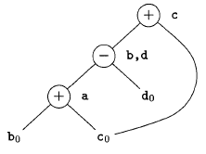

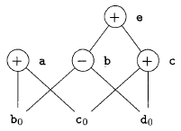

Finding Local Common Subexpressions
Common subexpressions can be detected by noticing, as a new node M is about to be added, whether there is an existing node N with the same children, in the same order, and with the same operator.

Slide 65
Finding Local Common Subexpressions
Dead Code Elimination
We delete from a DAG any root (node with no ancestors) that has no live variables attached.
Repeated application of this transformation will remove all nodes from the DAG that correspond to dead code.
Ex: If, in ex 2, a and b are live but c and e are not, we can immediately remove the root labelled e.
Then, the node labelled c becomes a root and can be removed.
The roots labelled a and b remain, since they each have live variables attached.

Slide 66





The Use of Algebraic Identities
Arithmetic identities
Constant folding: 2 * 3.14 would be replaced by 6.28
General algebraic transformations such as commutativity and associativity
* is commutative; that is, x* y = y*x
Associative laws might also be applicable to expose common subexpressions.

Slide 67
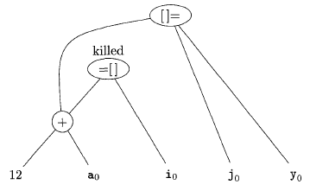

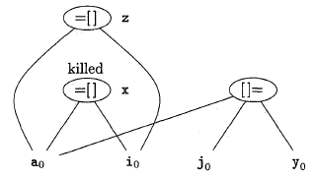

The Use of Algebraic Identities
Representation of Array References

Slide 68




Pointer Assignments and Procedure Calls
When we assign indirectly through a pointer, as in the assignments we do not know what p or q point to.
Reassembling Basic Blocks From DAG's

Slide 69
A Simple Code Generator
One of the primary issues during code generation is deciding how to use registers to best advantage.
There are four principal uses of registers:
Some or all of the operands of an operation must be in registers in order to perform the operation.
Registers make good temporaries - places to hold the result of a subexpression while a larger expression is being evaluated.
Registers are used to hold (global) values that are computed in one basic block and used in other blocks.
Registers are often used to help with run-time storage management.

Slide 70
A Simple Code Generator
The machine instructions are of the form
LD reg, mem
ST mem, reg
OP reg, reg, reg

Slide 71
Register and Address Descriptors
Our code-generation algorithm considers each three-address instruction in turn and decides what loads are necessary to get the needed operands into registers.
In order to make the needed decisions, we require a data structure that tells us what program variables currently have their value in a register, and which register or registers, if so.

Slide 72
Register and Address Descriptors
The desired data structure has the following descriptors:
For each available register, a register descriptor keeps track of the variable names whose current value is in that register.
For each program variable, an address descriptor keeps track of the location or locations where the current value of that variable can be found.
The location might be a register, a memory address, a stack location, or some set of more than one of these.

Slide 73
The Code-Generation Algorithm
An essential part of the algorithm is a function getReg(I), which selects registers for each memory location associated with the three-address instruction I.
Function getReg has access to the register and address descriptors for all the variables of the basic block and the variables that are live on exit from the block.

Slide 74
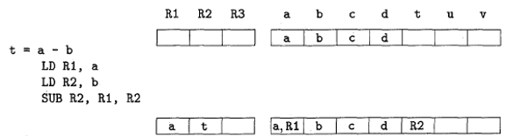

The Code-Generation Algorithm
Managing Register and Address Descriptors Example
Let us translate the basic block consisting of the three-address statement:

Slide 75
The Code-Generation Algorithm
Machine Instructions for Operations
For a three-address instruction such as x = y + z, do the following:
1. Use getReg(x = y + z) to select registers for x, y, and z. Call these R_{x}, R_{y} and R_{z}.
2. If y is not in R_{y} (according to the register descriptor for R_{y}), then issue an instruction LD R_{y}, y', where y' is one of the memory locations for y (according to the address descriptor for y).
3. Similarly, if z is not in R_{z}, issue and instruction LD R_{z}, z', where z' is a location for z .
4. Issue the instruction ADD R_{x}, R_{y} , R_{z}.

Slide 76
The Code-Generation Algorithm
Machine Instructions for Copy Statements
There is an important special case: a 3-address copy statement of the form x = y.
We assume that getReg will always choose the same register for both x and y.

Slide 77
The Code-Generation Algorithm
Ending the Basic Block
Variables used by the block may wind up with their only location being a register
If the variable is live on exit from the block, or if we don't know which variables are live on exit, then we need to assume that the value of the variable is needed later.
In that case, for each variable x whose location descriptor does not say that its value is located in the memory location for x, we must generate the instruction ST x, R, where R is a register in which x's value exists at the end of the block.

Slide 78
The Code-Generation Algorithm
Managing Register and Address Descriptors
As the code-generation algorithm issues load, store, and other machine instructions, it needs to update the register and address descriptors.
The rules are as follows:
1. For the instruction LD R, x
(a) Change the register descriptor for register R so it holds only x.
(b) Change the address descriptor for x by adding register R as an additional location

Slide 79
The Code-Generation Algorithm
2. For the instruction ST x, R, change the address descriptor for x to include its own memory location.
3. For an operation such as ADD R_{x}, R_{y}, R_{z} implementing a 3-addr instrn x = y + z
(a) Change the register descriptor for R_{x} so that it holds only x.
(b) Change the address descriptor for x so that its only location is R_{x}.
(c) Remove R_{x} from the address descriptor of any variable other than x.

Slide 80
The Code-Generation Algorithm
4. When we process a copy statement x = y, after generating the load for y into register R_{y}, if needed, and after managing descriptors as for all load statements:
(a) Add x to the register descriptor for R_{y}.
(b) Change the address descriptor for x so that its only location is R_{y} .

Slide 81
The Code-Generation Algorithm
Design of the Function getReg
Let us consider how to implement getReg(I), for a three-address instruction I.
We again use x = y + z as the generic example.
The rules are as follows:
If y is currently in a register, pick a register already containing y as R_{y}.
If y is not in a register, but there is a register that is currently empty, pick one such register as R_{y}.
The difficult case occurs when y is not in a register, and there is no register that is currently empty. We need to pick one of the allowable registers anyway, and we need to make it safe to reuse.

Slide 82
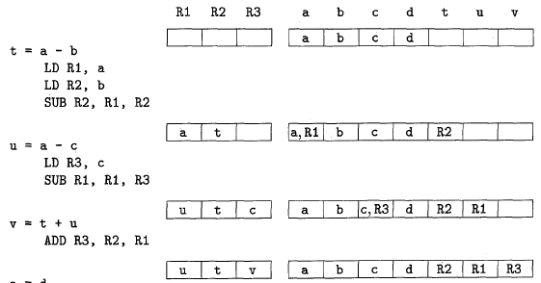

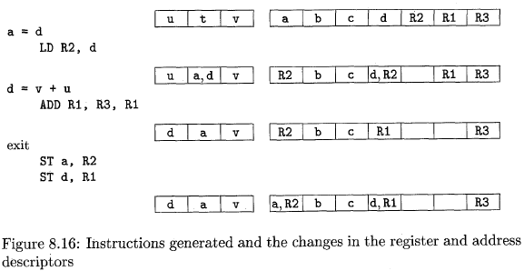
The Code-Generation Algorithm
Managing Register and Address Descriptors Example
Let us translate the basic block consisting of the three-address statements

Slide 83
THANK
YOU

